Slide 1

Spam Slayer
A web app to slay Amazon fake reviews

Slide 2
Pop Quiz: which of the following review is deceptive?
My recent stay at the Amalfi Hotel in Chicago couldn't have gone worse. Apart from the price of staying there and the slow response time of hotel staff I was totally let down by the food that could be found there. There are many attractions in the area and indeed leaving the hotel is the best part of the experience.
When my husband and I went to Amalfi Hotel we were expecting first class service. First, when we got there we learned they had given our room to another guest and we were not able to get a suite like we had booked. Room service took forever and the food was subpar. Supposedly they had planners to help explore the area, but we requested one and never saw hide nor hair of a planner. The spa staff seemed incompetent. The only positive things I can say about Amalfi Hotel was that the rooms were stylish as advertised. I give this hotel two stars.
(data from Ott et al. 2011)
Notes:
Define opinion spam:
fictitious opinions that have been deliberately written to sound authentic

Slide 3
And the answer is …...
BOTH OF THEM!

Slide 4
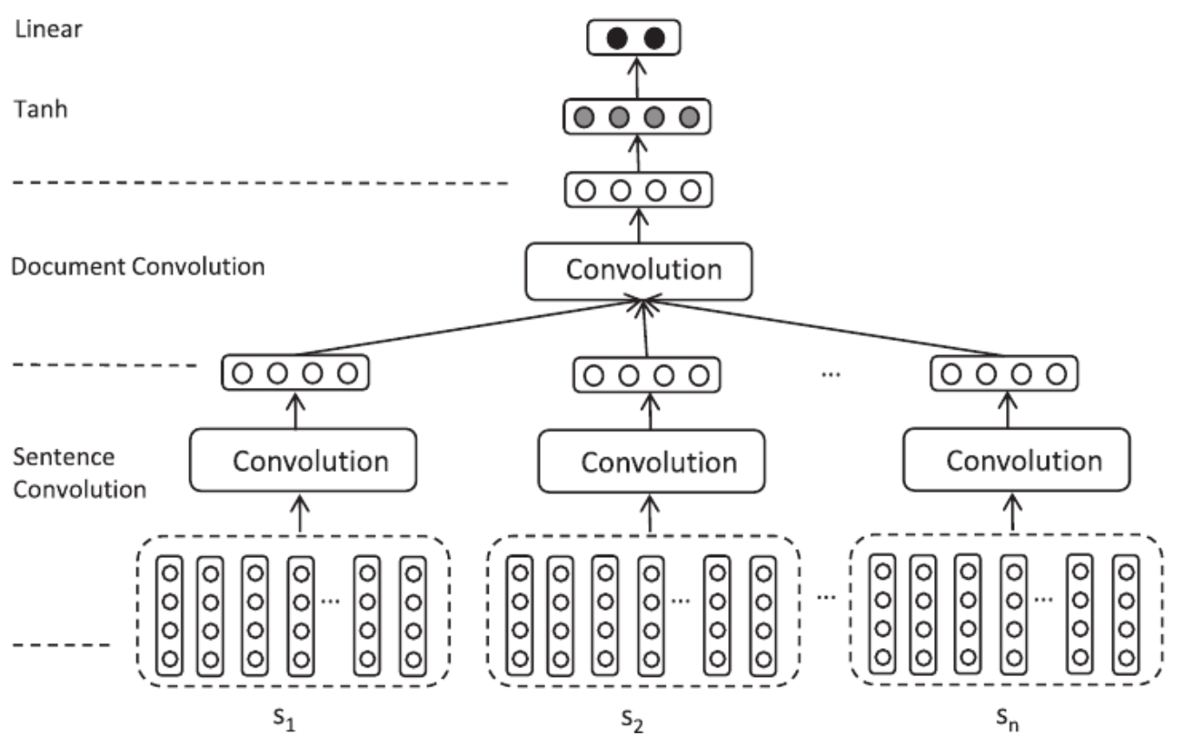
Convolutional Neural Network
without recurrent layers
Compare to bi-directional RCNN
Implementation of Li, Qin, Ren and Liu (2016) of the model
Sentence → Conv Layer → Word Embedding
2 convolutional layers
semantic meaning → local features
sentence convolution
document convolution
Li, Qin, Ren and Liu (2016)
Notes:
Yingqi
The first layer makes a composition of each sentence using a fix-length window, while the second layer transforms vectors of the sentences into a vector of document.

Slide 5
